Slide 1
Acentra Provider Portal Training
Withdrawal Management:
Creating Cases Effectively
Utilizing the Create a Case Wizard
Portal Submission Requirements

Slide 2
Disclaimer
The ASAM Criteria standards do not purport to set a medical or legal standard of care and may not encompass all levels of service options that may be available in a changing healthcare field. Therefore, The ASAM Criteria as presented and discussed may not be wholly relevant to all levels and modalities of care—such as forensic treatment facilities, custodial care providers, and addiction treatment programs that address concomitant developmental disability disorders, among others—nor to external judgments—such as those made by legal or regulatory entities concerning the appropriateness of patient admission into various levels of care. The ASAM Criteria is designed to serve as a resource for general, mental health, and addiction treatment clinicians and counselors but is not intended to substitute for their independent clinical judgment based on the particular facts and circumstances presented by individual patients.
The content in this training is used with permission from The ASAM Criteria: Treatment Criteria for Addictive, Substance-Related, and Co-occurring Conditions. Third Edition. © 2013.
All Rights Reserved. Unless authorized in writing by ASAM, no part may be reproduced or used in a manner inconsistent with ASAM’s copyright. This prohibition applies to unauthorized uses or reproductions in any form. ASAM is not affiliated with and is not endorsing this training program or vendor.
“ASAM,” “American Society of Addiction Medicine,” “ASAM Logo,” the ASAM logos and taglines, are registered trademarks of ASAM, and are used with permission. Use of these terms is prohibited without permission of ASAM. Use of these trademarks does not constitute endorsement of this training, product, or practice by ASAM.

Slide 3
SUBMISSION REQUIREMENTS: ASAM 3rd Edition
PART 1 |

Slide 4



OBJECTIVES
Utilization Management (UM) Workflow
Required Documentation
Provider Portal Assistance

Slide 5
REQUIRED DOCUMENTATION
3.7 Withdrawal Management
Comprehensive Assessment (completed within 72 hours of Admission) or Biopsychosocial Screening Assessment and Assessment Summary
Initial Stabilization Plan with measurable goals
Documentation of Treatment Services (aka: Progress Notes) through individual and group notes
Physician Exam completed by a MD, APRN, PA.
Withdrawal Scales: CIWA, COWS or equivalent standardized withdrawal scale
Medication Administration Record (MAR)
Documentation of Treatment Coordination (should be in ITP or Progress notes)
Discharge or Transition Summary identifying level of care client is moving to

Slide 6
REQUIRED DOCUMENTATION
3.2 Withdrawal Management
Comprehensive Assessment (completed within 72 hours of Admission) or Biopsychosocial Screening Assessment and Assessment Summary
Initial Stabilization Plan with measurable goals
Documentation of Treatment Services (aka: Progress Notes) through individual and group notes
Physician Exam completed by a MD, APRN, PA. if self-administered medications (as defined in 245G.08 Subd. 5) are given
Withdrawal Scales: CIWA, COWS or equivalent standardized withdrawal scale
Medication Administration Record (MAR)
Documentation of Treatment Coordination (should be in ITP or Progress notes)
Discharge or Transition Summary identifying level of care client is moving to

Slide 7
When to Submit a Case
Part 2

Slide 8
Review Letter
Cases are ONLY submitted after receiving a review letter from Acentra
These letters are sent out monthly
A follow up email is sent 5 days after the initial request. If cases have been submitted there is no need to respond.
Reminders: Ensure your contact information is up to date with Acentra.

Slide 9
Review Letter Components
Letter
Documentation
Spreadsheet
Claims Submission period: timeframe that the provider claims were submitted to the state
Must submit documentation for the entire length of stay that corresponds to the identified service dates and the respective level of care
Must submit ALL documentation listed for the type of treatment
  Outpatient/Residential
  Withdrawal Management
  Opioid Treatment (MOUD)
Only includes the date that was in the Claims file from DHS
  This is not the only date being reviewed

Slide 10
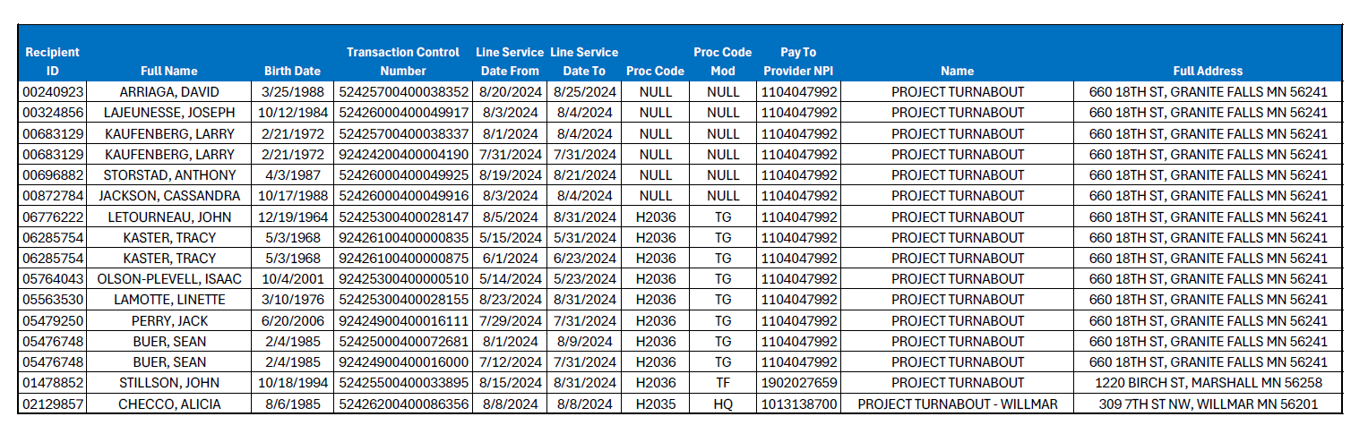
Example of Spreadsheet

Slide 11
ANG Creating Cases
PART 3

Slide 12

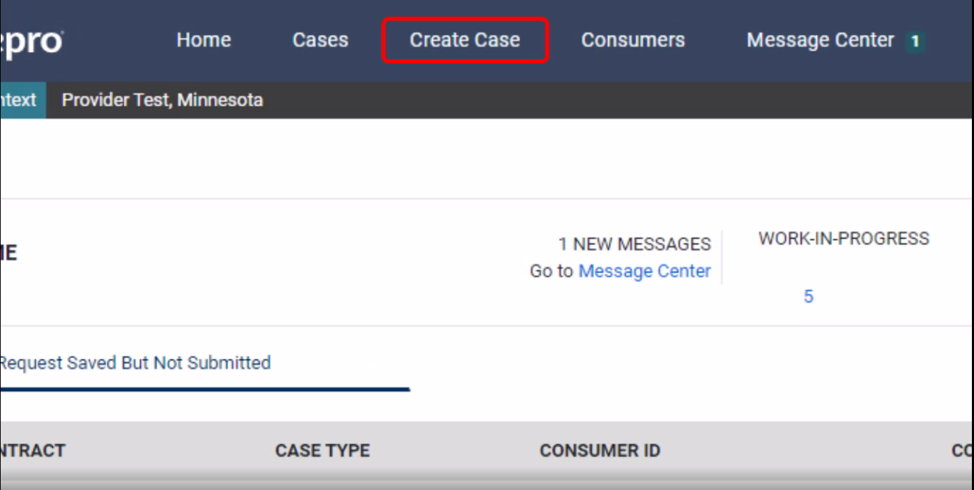
ANG Provider Portal
Successful Completion of setup/login directs user to the Home Page
After logging in from the home screen, click on “Create Case”.

Slide 13

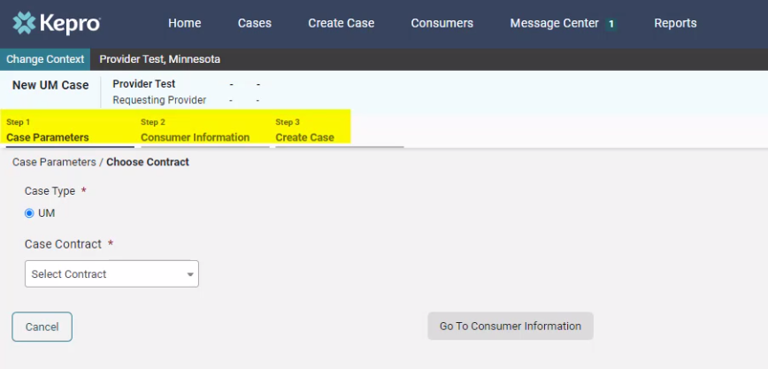
ANG Provider Portal
The Create a Case Wizard shows each section as a Step. The required information will be indicated by a red asterisk (*).
Create Case Wizard

Slide 14
Inpatient (Withdrawal Management) Cases

Slide 15

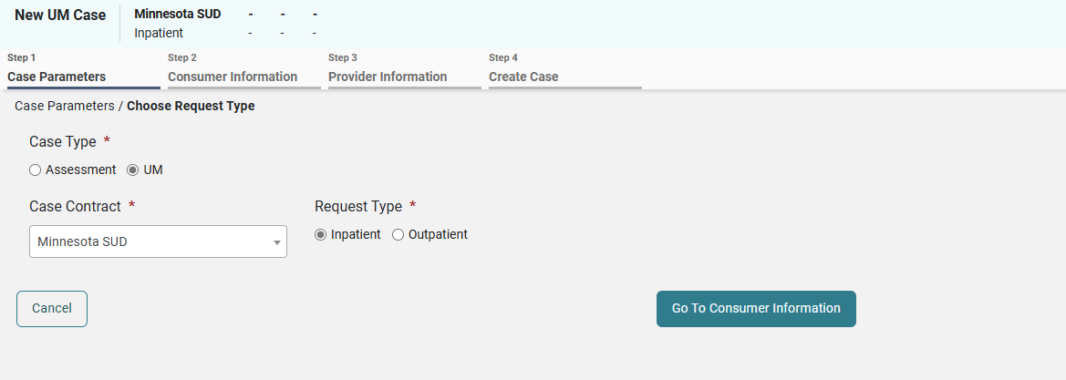
ANG Provider Portal
Case Parameters
Choose:
Case Type: “UM”
Case Contract: “Minnesota SUD”
Request Type:
  Inpatient: LOC 3.7WM or 3.2WM
Click “Go To Consumer Information” to continue.
Step 2
Step 1
Step 3

Slide 16

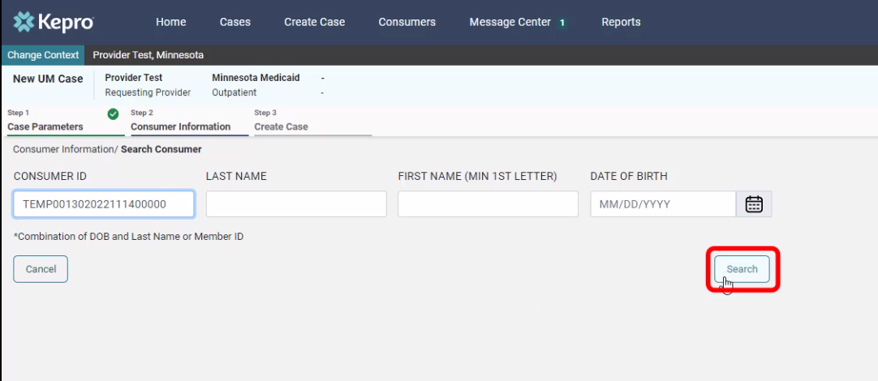
ANG Provider Portal
Consumer information
Search members by:
MN Member ID
Last Name & DOB
Click “Search to continue”

Slide 17

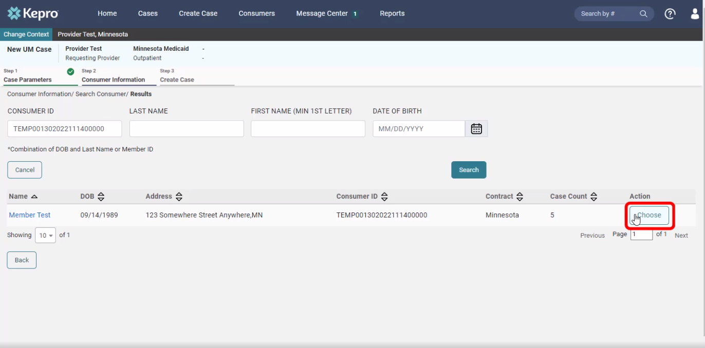
ANG Provider Portal
The members demographic information will display.
Consumer information
Verify member information.
Click “Choose” to continue.

Slide 18

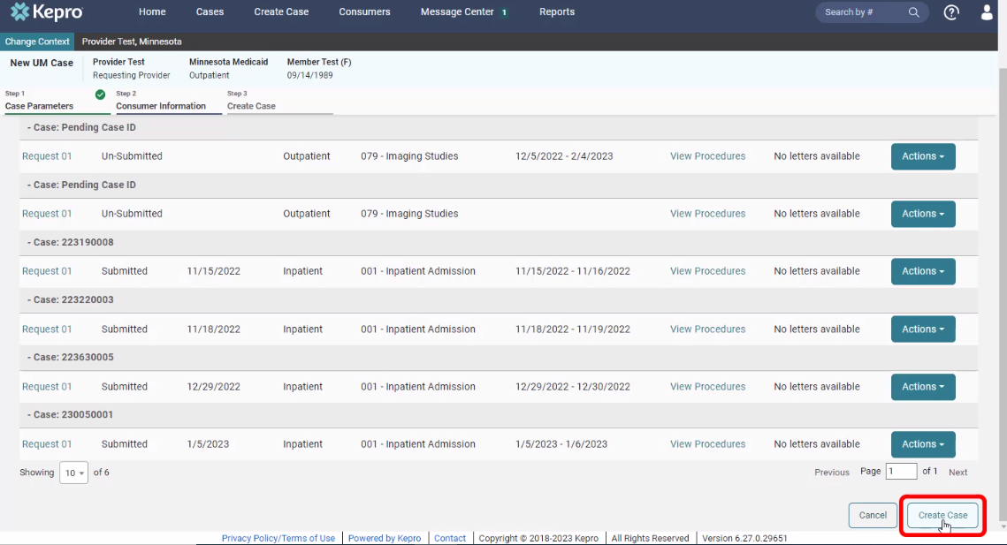
ANG Provider Portal
Consumer information
Previous cases submitted for this member will be displayed.
Click on “Create Case” to continue.

Slide 19

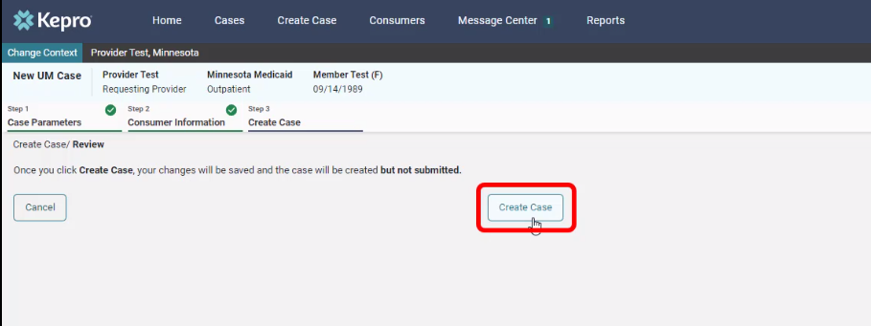
ANG Provider Portal
Disclaimer
CREATE CASE
Notification prompt displays:
“Once you click Create Case, your changes will be saved and the case will be created; BUT
Case WILL NOT be submitted”

Slide 20

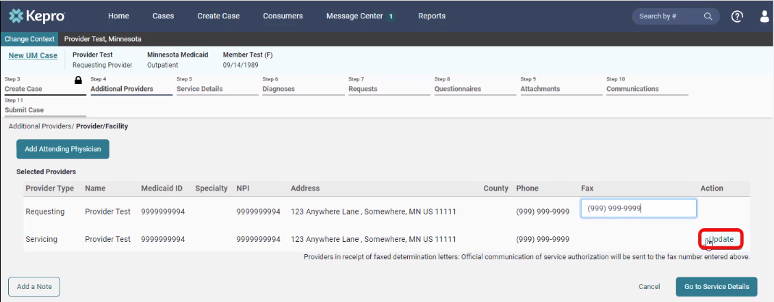
ANG Provider Portal
Additional providers
Entering the attending physician is not necessary for ASAM UM
Update the Servicing Provider by clicking on “Update”

Slide 21

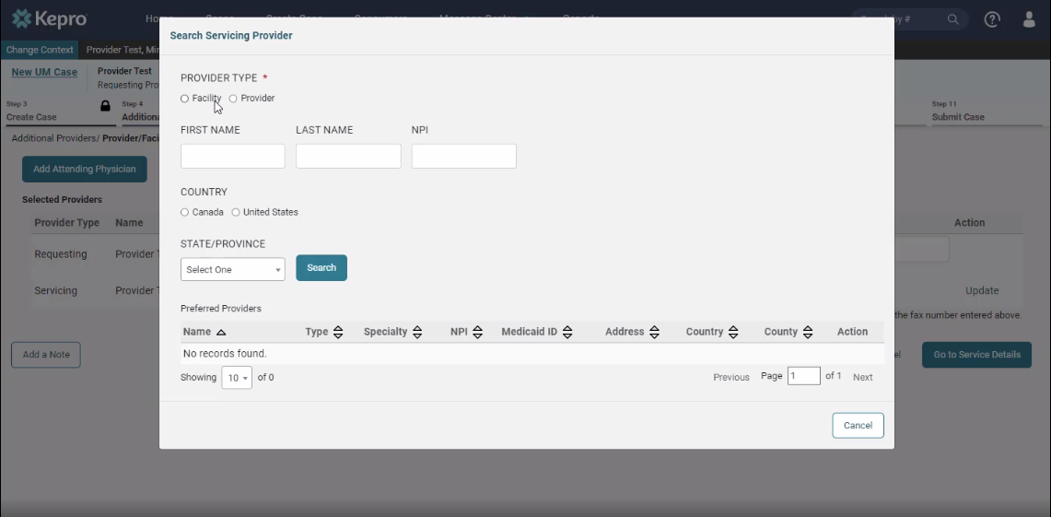
ANG Provider Portal
ADDITIONAL PROVIDERS
If registered as a facility, search using “Facility”.
If registered as a provider, search using “Provider”.

Slide 22

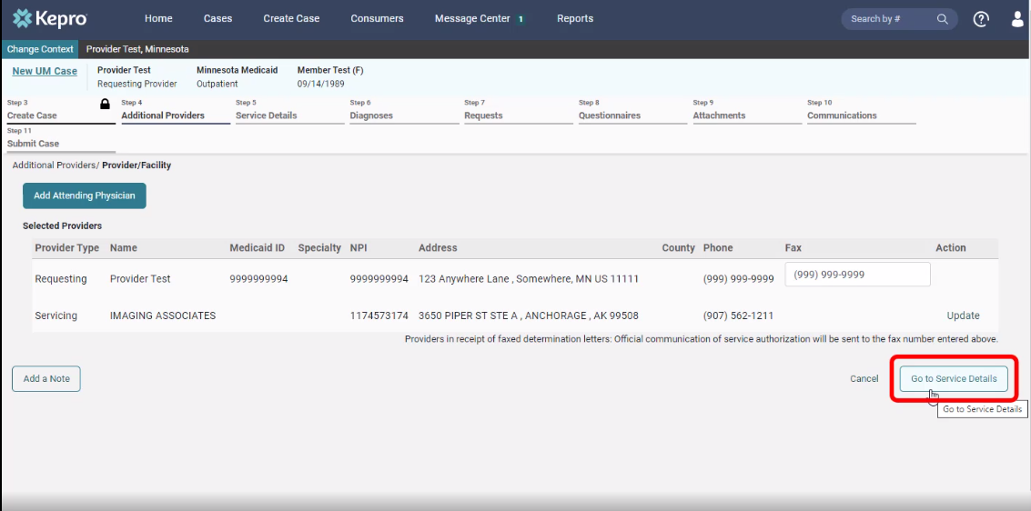
ANG Provider Portal
Fips code
Verify provider information
Click on “Go to service details” to continue.

Slide 23
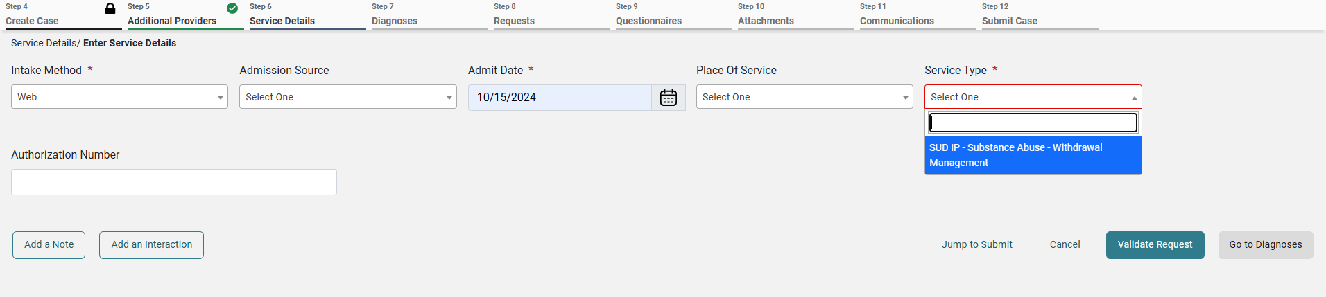
ANG Provider Portal
11
Service details
Choose:
Place of Service: Optional
Service Type:
  SUD IP
Click on “Go to Diagnosis” to continue

Slide 24
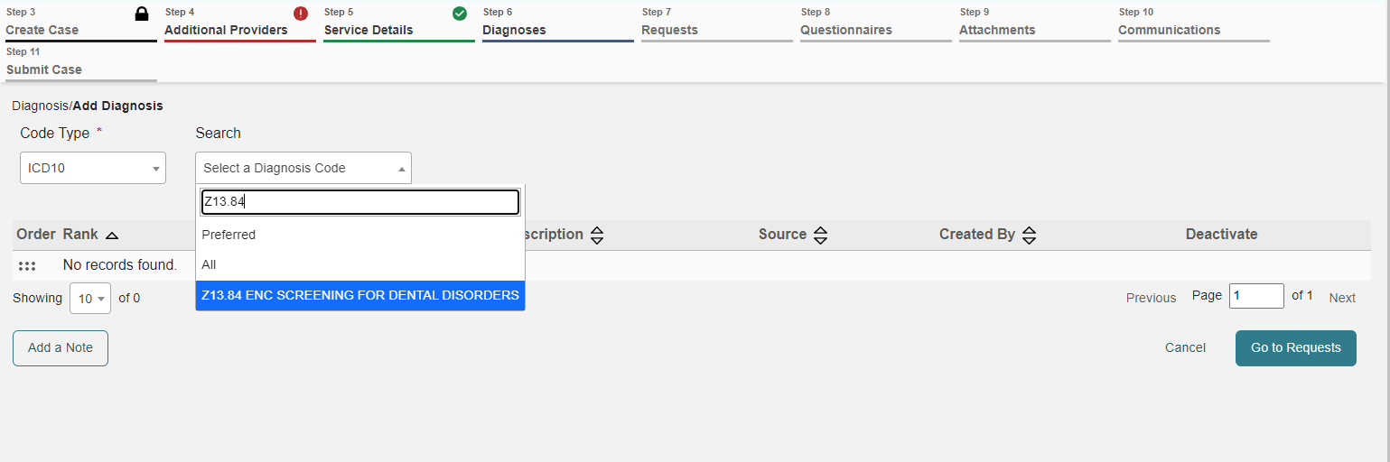
ANG Provider Portal
12
diagnosis
Choose:
Code Type: “ICD 10” from the drop down,
Enter the diagnosis code to search.
Select the correct code from the drop down,
Click “Go to Requests” to continue
Select SUD Diagnoses/Mental Health Diagnoses

Slide 25
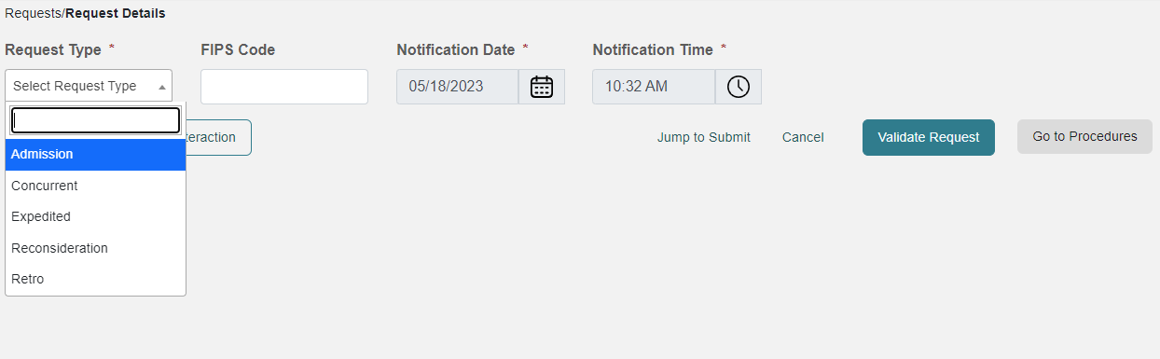
ANG Provider Portal
13
requests
Choose Request Type
  Admission= beginning treatment
  Concurrent= client is currently receiving treatment
The notification date and time will display automatically.
Click on “Go to Procedures” to continue.
FIPS Code field is not required for 1115 SUD submissions, leave blank and continue.

Slide 26
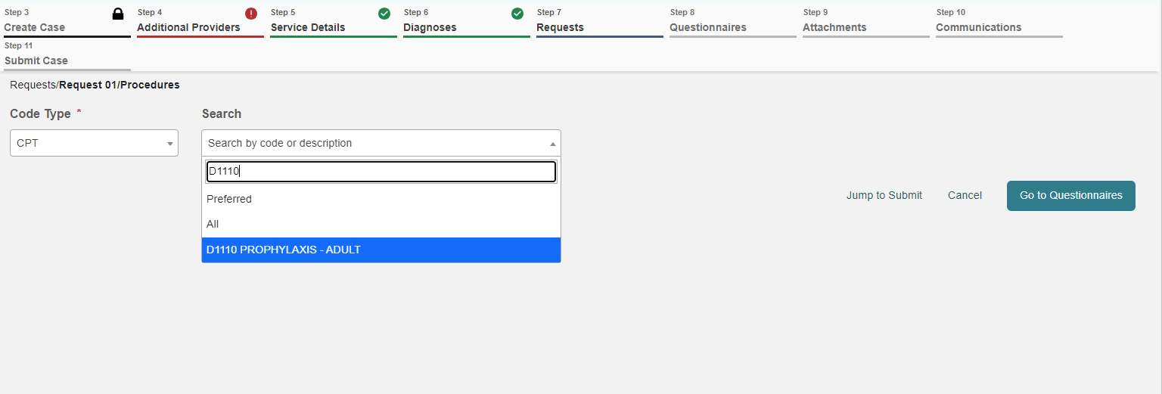
ANG Provider Portal
14
requests
Enter the procedure code in search bar:
This will be the CPT Code billed to DHS
  Check with your billing person if unsure on what code to use
Select the correct code from the drop-down.
The Monthly Records Request Letter contains code required for each client
H2036
Residential Program

Slide 27
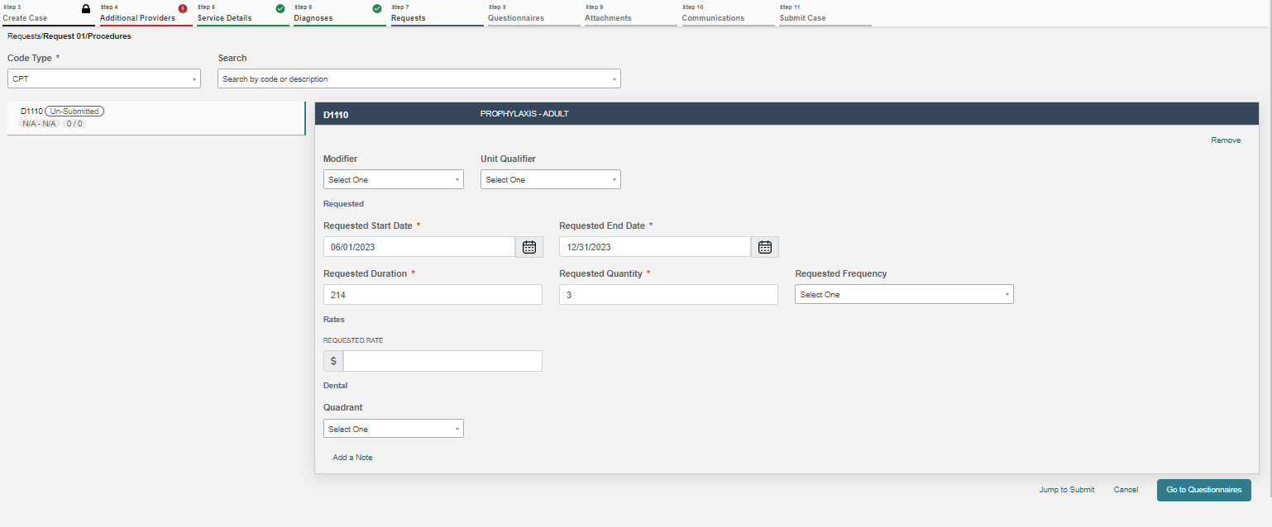
ANG Provider Portal
15
Requests
REQUEST 01 WILL DISPLAY
Enter Requested Start Date.
Enter the Requested Duration (this will populate the correct Requested End date).
  The start date will be the date client entered that episode of care
  End Date will vary as noted:
    Discharge Date
    Residential Cases: 1 month (if still in services)
    Outpatient Cases: 3 months (if still in services)
Enter the Requested quantity.
Repeat the process for additional procedure codes by entering an additional code in the search field.
Click “Go to Questionnaire”
H2036 tx program, per deim
01/01/23
06/30/23
180
5760
Units
Leave Rate Blank
*Providers are not permitted to submit cases as “insufficient information” status (warning message will pop-up that will prompt you to correct the error).

Slide 28
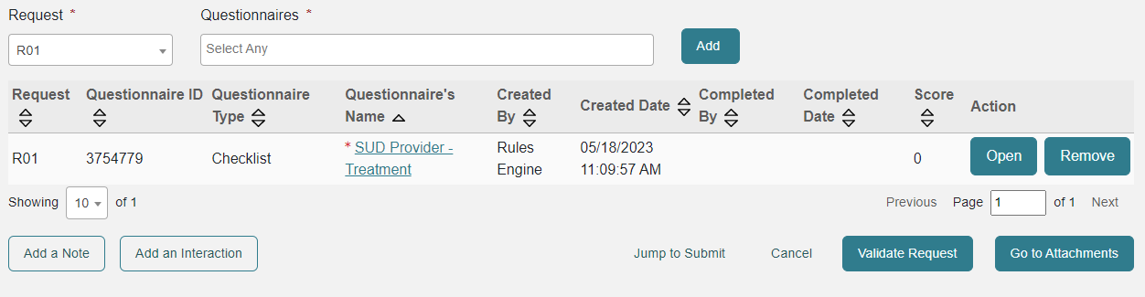
ANG Provider Portal
16
questionnaire
SUD Questionnaire is required to be completed before the case can be submitted
Click on “Take or Open” under Action to complete the questionnaire.
Upon questionnaire completion, click on “Go to Attachments” to upload the documents.

Slide 29
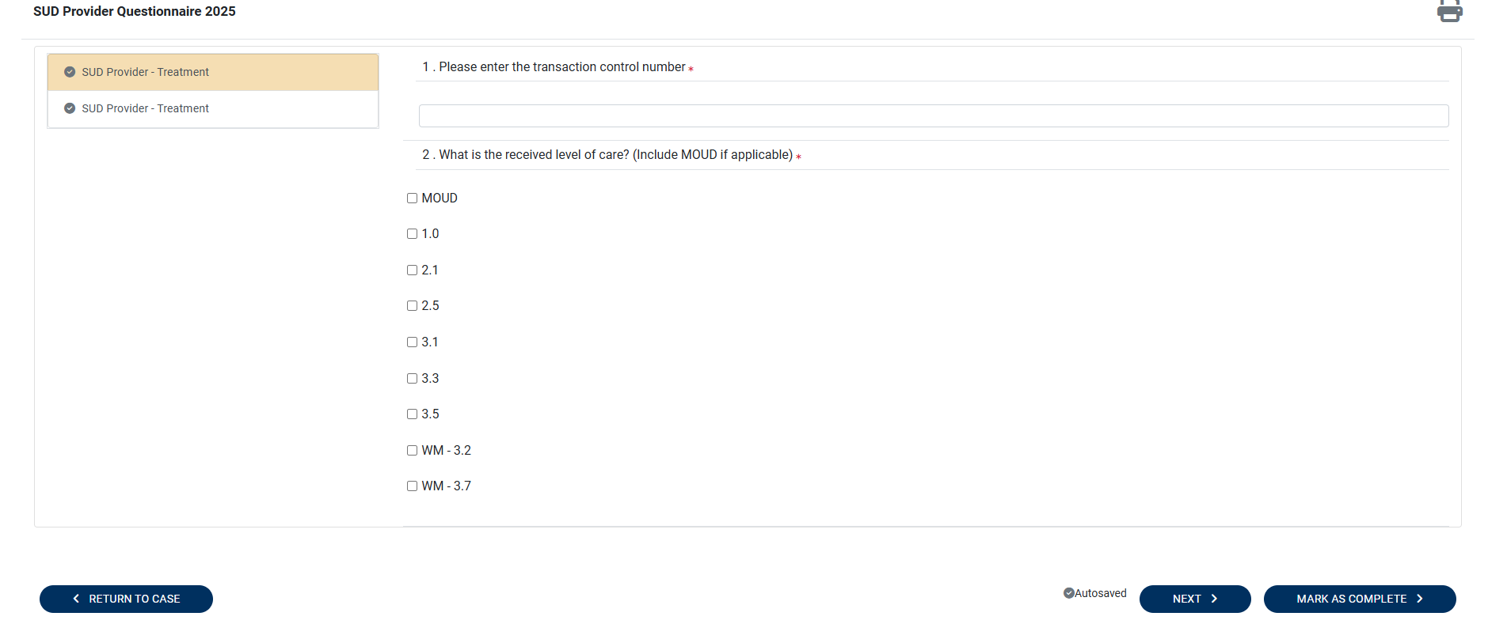
ANG Provider Portal
16
Questionnaire
Transaction Control Number (TCN) is found on Request for Review Letter from Acentra
  You may enter more than one TCN
All questions must be answered before the questionnaire can be marked complete
Click “Next” to move through pages
Transaction Control Number (TCN)
Provided to Acentra by DHS
Claims identification number
Used for internal tracking purposes
Must be provided on submitted cases
Included in the monthly letter from Acentra
If there are further questions, please reach out to DHS

Slide 30
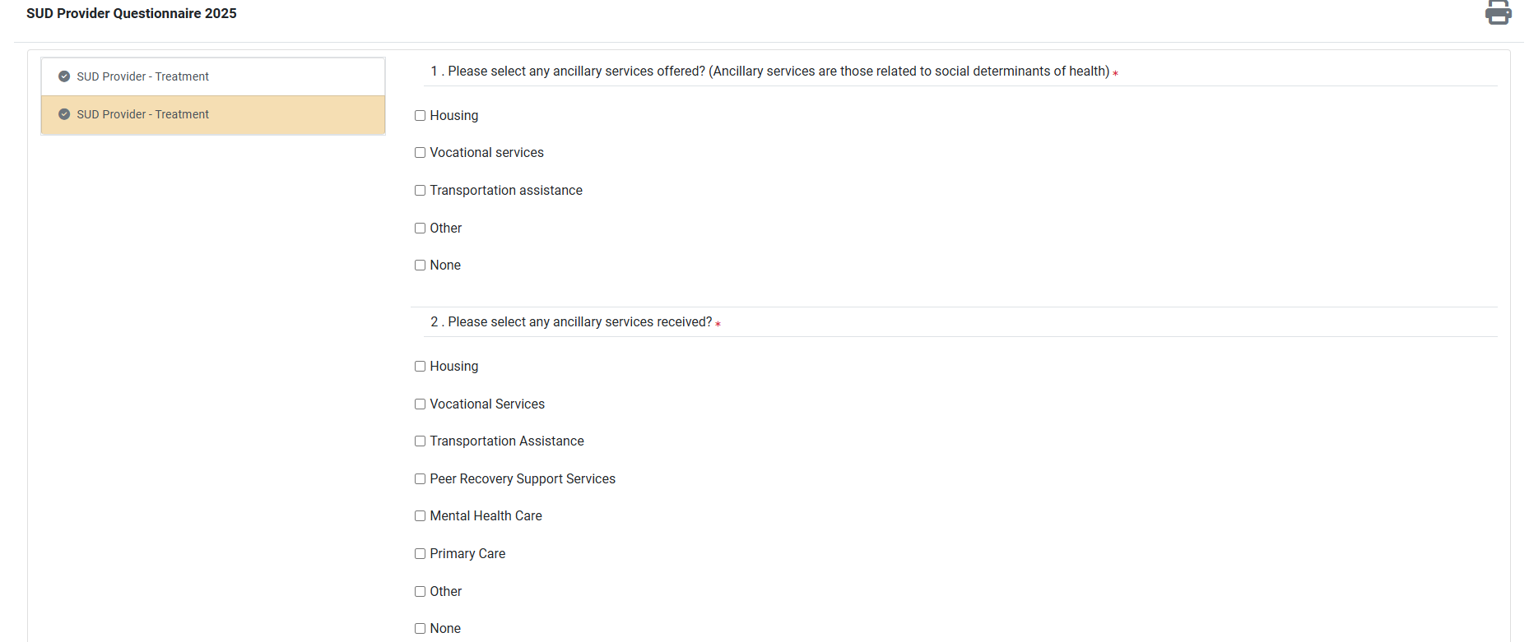
ANG Provider Portal
16
Questionnaire
SUD/ASAM Questionnaire is now included in this questionnaire
Dimension Ratings must be completed for each Dimension
Click “Next” to move through pages

Slide 31
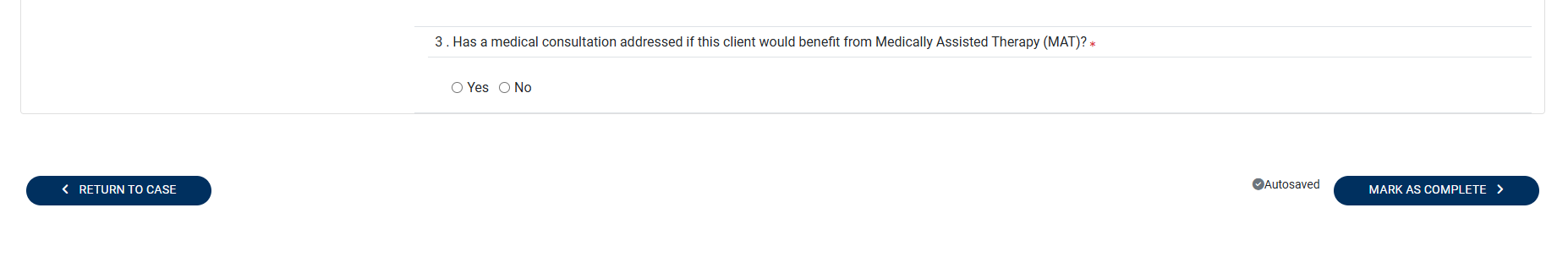
ANG Provider Portal
16
Questionnaire
Select All other services offered and/or provided to client
Question 4 will populate additional questions if MAT would be a benefit to client
Click “Mark as Complete” to finish

Slide 32
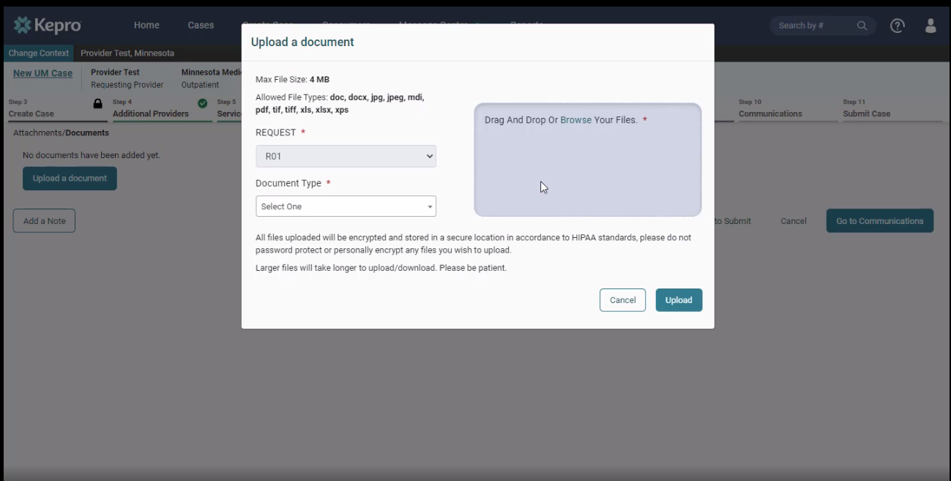
ANG Provider Portal
17
attachments
Click on “Upload documents.”
*You can drag and drop your documents, or you can browse your files.
Choose the appropriate document types
  PDF is the preferred file type for uploads
Once the documents are chosen, click on “Upload.”

Slide 33

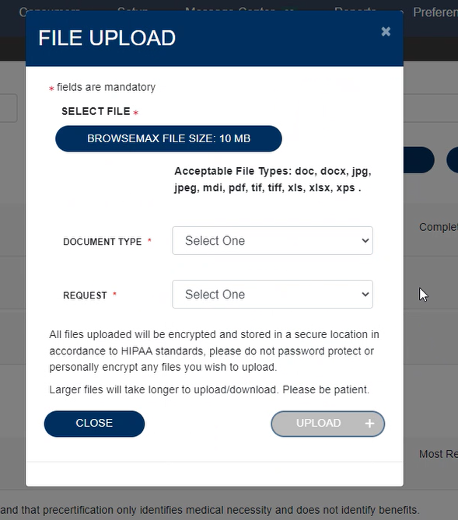
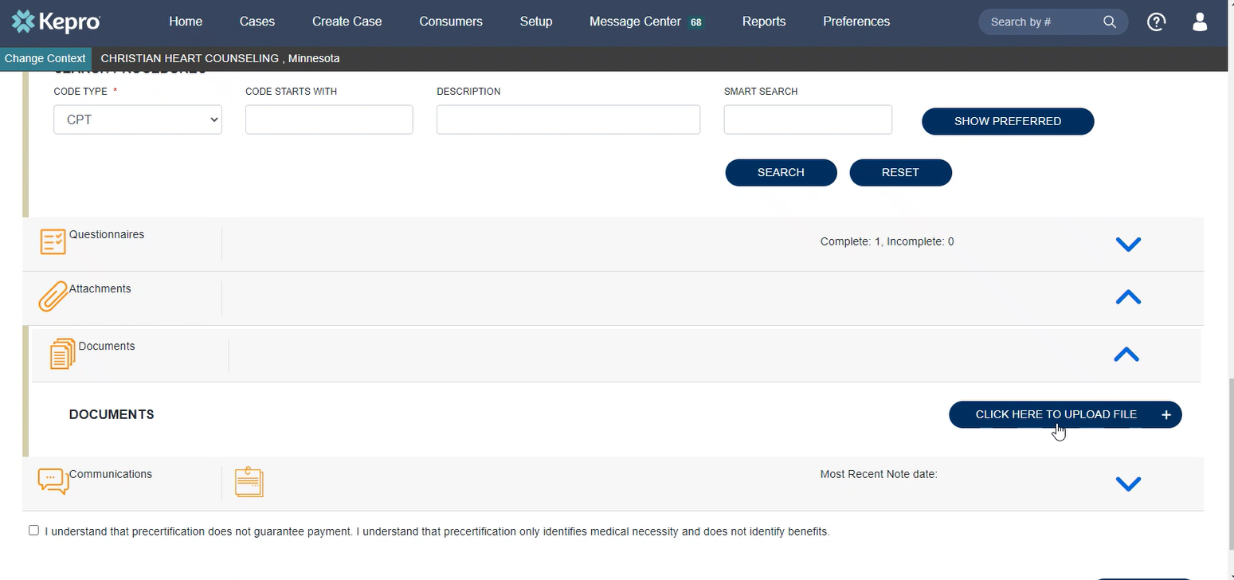
ANG Provider Portal
Step
Attaching documents continued
(*same steps for attaching documents to a pended case*)
ADDING ADDITIONAL INFORMATION TO A PENDED CASE
Expand the “Attachments” Folder by pressing on the arrow.
Expand the “Documents” Folder by pressing on the arrow.
Click the “Click Here to Upload” Button.
Upload documents in the same manner as the initial case creation.

Slide 34
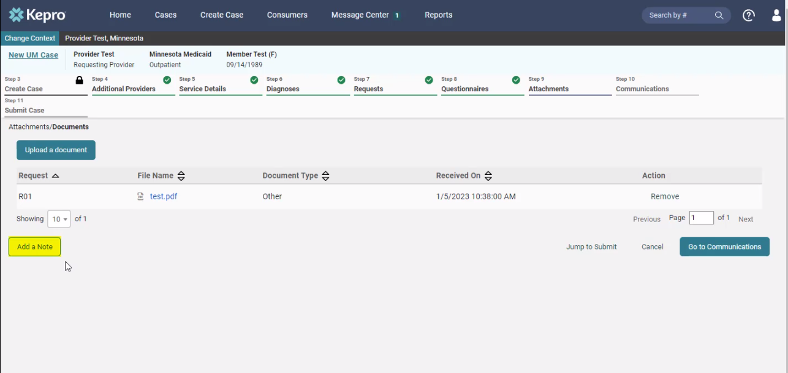
ANG Provider Portal
17
Case note
Each step has a “Add a note” button displayed on the bottom left.
*A note can be added any time throughout the creation of the request; however, it is not necessary.
Examples of case notes:
  PPHP/PMAP start and end dates
  Discharge Date
  Additional TCN (if there was not enough room in questionnaire
*Please be advised when responding to this request, clinical rationale/medical necessity information must be captured within the physical record (written documentation) and not solely entered as a case note.

Slide 35
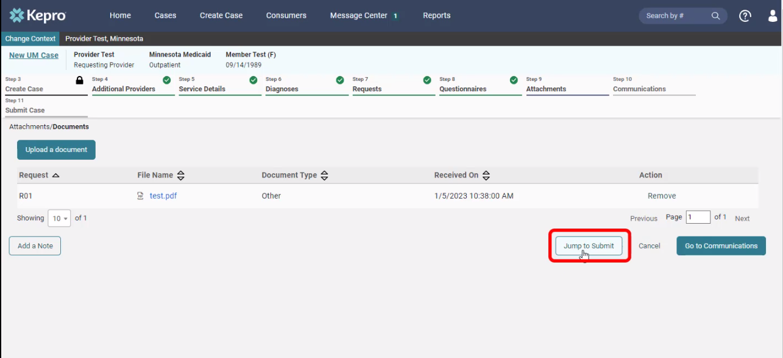
ANG Provider Portal
18
attachments
Click on “Jump to Submit” when all the steps are completed, and a case note has been entered (if necessary).

Slide 36
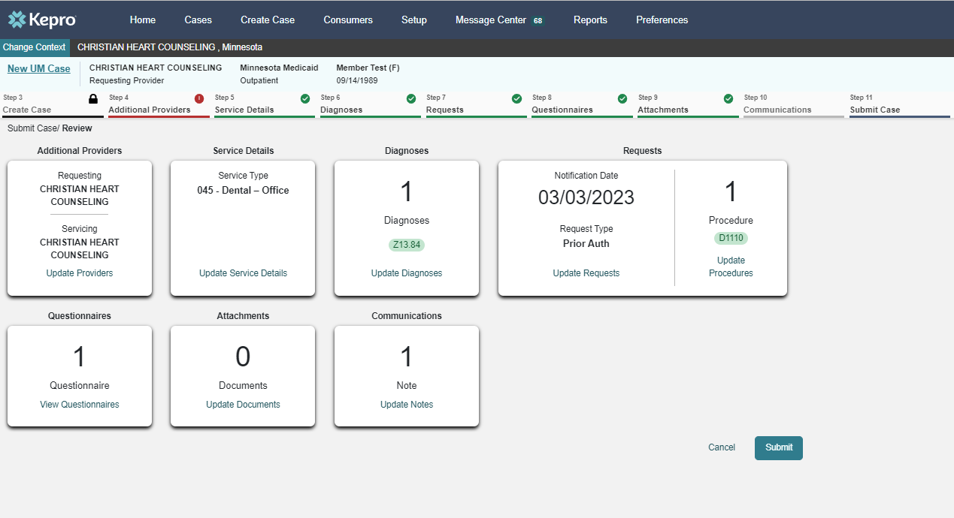
ANG Provider Portal
19
communications
Review the request.
If any changes need to be made, click on “Update” in any section.
If everything is correct, click on “Submit”.
SUD
F15
97153

Slide 37
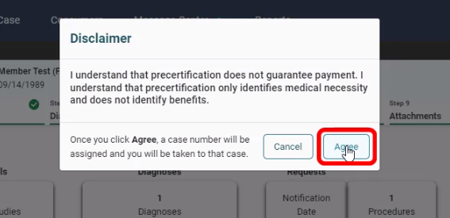
ANG Provider Portal
20
disclaimer
Click “Agree” on the disclaimer.

Slide 38
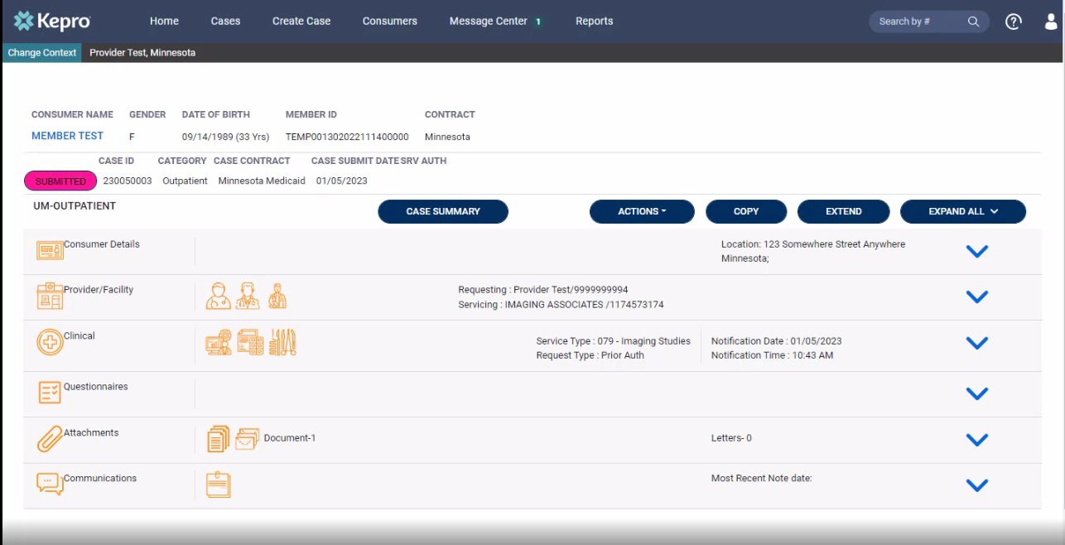
ANG Provider Portal
21
completion
Completed request that is now ready for review by Kepro staff.
Please print or record case number. This will allow for tracking case status, checking for pended information requests or to enter questions into the messaging system.

Slide 39
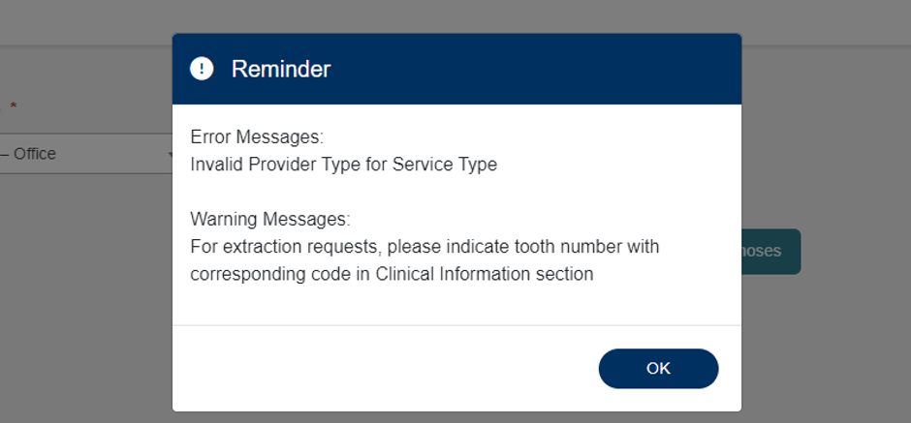
ANG Provider Portal
22
Error messages
If applicable, error messages will appear, prohibiting request submission.
Errors will disappear as information is added or corrected.
If “Invalid Provider Type” error message appears, an incorrect provider type was selected.

Slide 40

Notes:
Inpatient case

Slide 41
Switch Between Provider Locations

Slide 42
ANG Provider Portal
24
Multiple locations for provider
If your organization has multiple locations, they are all available under the username
Use Change Context to swap between locations
    Click: there will be a list of all locations associated with your user account

Slide 43
ANG Provider Portal: Message Center
PART 5

Slide 44
ANG Provider Portal
View Messages
After a case has been reviewed; the provider will receive an email that case id ###### has new information.
To view this
Use the Search by # box to enter the case ID and go directly to that case
Scroll down to Communications and click the arrow
From here you will have the option to look at notes and messages
-Reviewer notes are entered in the Notes section unless it’s a response to a message the provider sent in the Messages section

Slide 45

Notes:
Message center

Slide 46
Additional Training Opportunities
1115 Substance Use Disorder (SUD) System Reform Demonstration Clinical
DHS - 1115 SUD Trainings
Acentra Provider Portal Registrations and Training
(this presentation will be uploaded there)
https://mhcp.acentra.com/training/
American Society of Addiction Medicine
www.asam.org

Slide 47
Acentra Training Opportunities
MONTHLY: Acentra training series on Provider Portal and other necessary topics.
Monthly: 2nd Friday | 11:00 12:00 pm CST
Format: Teams Meeting
Registration Required: NO
MONTHLY: ASAM Lunch & Learn
Topic: ASAM 3rd Edition Trends, LOCs, Medical Necessity, Documentation Standards, etc..
Quarterly: 4th Wednesday of each month
12 pm CST
Format: Webinar (new link for each month)
Registration Required: Yes
Monthly Acentra Provider Training Link

Slide 48

Question & Answer

Slide 49



Thank you for attending!
Please reach out with any questions you may have.
Additional clinical questions?
Need to obtain your Registration Number?
Minnesotaasam@acentra.com
Questions about the 1115 SUD System Reform Demonstration:
1115demonstration.dhs@state.mn.us
https://mhcp.acentra.com/

