Slide 1
Acentra Provider Portal Training:
ASAM UM Creating Cases Effectively
Utilizing the Create a Case Wizard
Portal Submission Requirements

Slide 2
Disclaimer
The ASAM Criteria standards do not purport to set a medical or legal standard of care and may not encompass all levels of service options that may be available in a changing healthcare field. Therefore, The ASAM Criteria as presented and discussed may not be wholly relevant to all levels and modalities of care—such as forensic treatment facilities, custodial care providers, and addiction treatment programs that address concomitant developmental disability disorders, among others—nor to external judgments—such as those made by legal or regulatory entities concerning the appropriateness of patient admission into various levels of care. The ASAM Criteria is designed to serve as a resource for general, mental health, and addiction treatment clinicians and counselors but is not intended to substitute for their independent clinical judgment based on the particular facts and circumstances presented by individual patients.
The content in this training is used with permission from The ASAM Criteria: Treatment Criteria for Addictive, Substance-Related, and Co-occurring Conditions. Third Edition. © 2013.
All Rights Reserved. Unless authorized in writing by ASAM, no part may be reproduced or used in a manner inconsistent with ASAM’s copyright. This prohibition applies to unauthorized uses or reproductions in any form. ASAM is not affiliated with and is not endorsing this training program or vendor.
“ASAM,” “American Society of Addiction Medicine,” “ASAM Logo,” the ASAM logos and taglines, are registered trademarks of ASAM, and are used with permission. Use of these terms is prohibited without permission of ASAM. Use of these trademarks does not constitute endorsement of this training, product, or practice by ASAM.

Slide 3
SUBMISSION REQUIREMENTS: ASAM 3rd Edition
PART 1 |

Slide 4
OBJECTIVES
Portal Registration
Monthly Letters
Provider Portal Workflow & Assistance

Slide 5
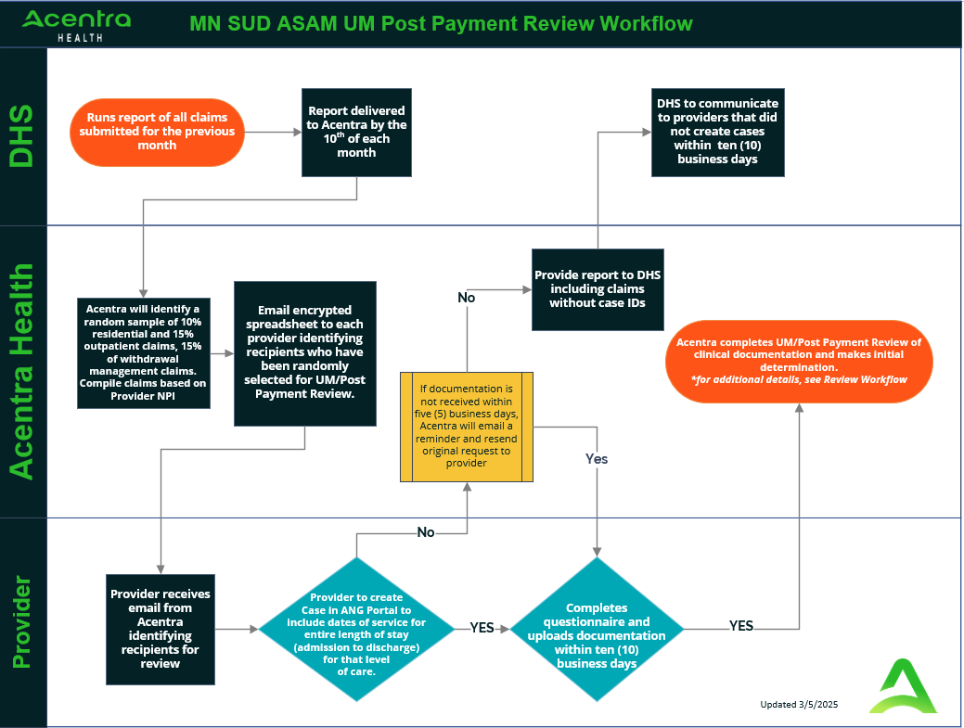
MN SUD ASAM UM Acentra Health
Post Payment Review Workflow

Slide 6
When to Submit a Case
Part 2

Slide 7
Review Letter
Cases are ONLY submitted after receiving a review letter from Acentra
These letters are sent out monthly
A follow up email is sent 5 days after the initial request. If cases have been submitted there is no need to respond.
Reminders: Ensure your contact information is up to date with Acentra.

Slide 8
Review Letter Components
Letter
Documentation
Spreadsheet
Claims Submission period: timeframe that the provider claims were submitted to the state
Must submit documentation for the entire length of stay that corresponds to the identified service dates and the respective level of care
Must submit ALL documentation listed for the type of treatment
Outpatient/Residential
Withdrawal Management
Opioid Treatment (MOUD)
Only includes the date that was in the Claims file from DHS
This is not the only date being reviewed

Slide 9
Example of Spreadsheet

Slide 10
ANG Provider Portal
PART 3

Slide 11
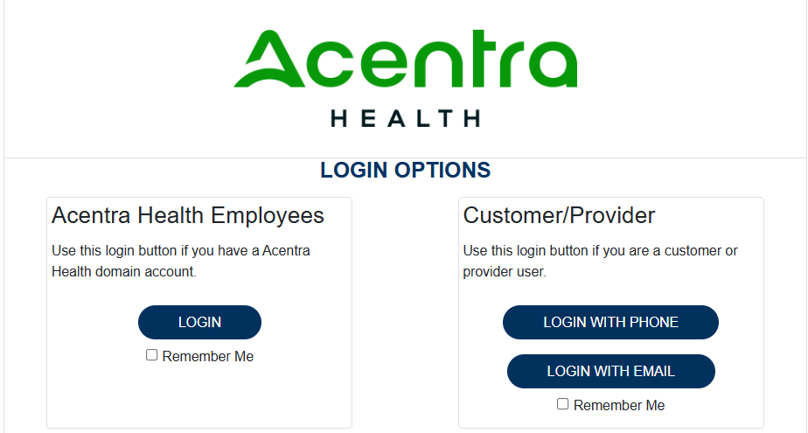
ANG Provider Portal
Training Website:
For in-depth training on the new ANG Platform, please visit:
mhcp.acentra.com/sud-resources/
> ANG Provider Portal
ANG Provider Portal allows for:
Secure access to ANG Connect (Provider Portal)
Provider will be able to access letters by Case/Request, Respond/Send messages To/From Acentra
Receipt of a Acentra Case ID# to confirm Acentra has successfully received your submission.

Slide 12
Accessing ANG (Atrezzo) Provider Portal
Email Minnesotaasam@acentra.com
Provider Reaches out to Minnesotaasam@acentra.com with 1115 Approval Letter and NPI to obtain their registration number
Go to ANG Portal
Provider will go to portal.Kepro.com and click “Register Here”
Website: https://portal.Kepro.com
Registered Provider:
Complete Registration and create username

Slide 13
Logging into ANG (Atrezzo) Provider Portal
First Time Logging into ANG
Before logging into ANG for the first time must complete multifactor authentication https://5627605.fs1.hubspotusercontent-na1.net/hubfs/5627605/MNHCP%20Atrezzo%20Provider%20Portal%20Login-1.mp4)
ANG Portal Log in
Login using Customer/Provider option
Website: https://portal.Kepro.com
Issues Logging in and already registered?
Contact: MinnestoaASAM@acentra.com

Slide 14
Please note: Email address referenced has been updated to MinnesotaASAM@Acentra.com
Notes:
Portal registration

Slide 15
Additional Training Opportunities
1115 Substance Use Disorder (SUD) System Reform Demonstration Clinical
DHS - 1115 SUD Trainings
Acentra Provider Portal Registrations and Training (this presentation will be uploaded there)
https://mhcp.acentra.com/training/
American Society of Addiction Medicine
www.asam.org

Slide 16
Acentra Training Opportunities
MONTHLY: Acentra training series on Provider Portal and other necessary topics.
Monthly: 2nd Friday | 11:00 12:00 pm CST
Format: Teams Meeting
Registration Required: NO
MONTHLY: ASAM Lunch & Learn
Topic: ASAM 3rd Edition Trends, LOCs, Medical Necessity, Documentation Standards, etc..
Quarterly: 4th Wednesday of each month
12 pm CST
Format: Webinar (new link for each month)
Registration Required: Yes
Monthly Acentra Provider Training Link

Slide 17
Question & Answer

Slide 18
Thank you for attending!
Please reach out with any questions you may have.
Additional clinical questions?
Need to obtain your Registration Number?
Minnesotaasam@acentra.com
Questions about the 1115 SUD System Reform Demonstration:
1115demonstration.dhs@state.mn.us
https://mhcp.acentra.com/

