Slide 1
Dental Atrezzo Provider Portal training
Utilizing the Create a Case Wizard
Portal Submission Requirements

Slide 2
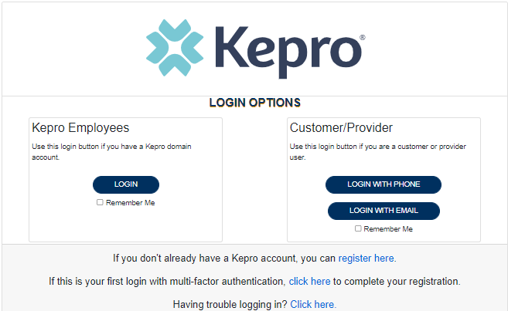
Atrezzo Provider Portal
Training Website:
For in-depth training on the new Atrezzo Platform, please visit:
mhcp.Kepro.com/training
> Atrezzo Provider Portal
Training Video Link:
MHCP Atrezzo Portal Create Case Wizard Training Video
Atrezzo Provider Portal allows for:
Secure access to Atrezzo Connect (Provider Portal)
Provider will be able to access letters by Case/Request, Respond/Send messages To/From KEPRO
Receipt of a Kepro Case ID# to confirm Kepro has successfully received your submission.
D1110 Questionnaire Training |

Slide 3
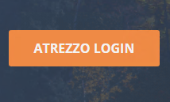
Accessing Atrezzo Provider Portal
Select “Atrezzo Login”
To Register for Atrezzo Provider Portal :
Enter your 10 digit National Provider Identifier (NPI) number and Provider Registration Code (Provider to call Kepro Customer Service (866) 433-3658 to obtain registration code)
Website: https://mhcp.kepro.com
Registered Provider:
Enter your unique username and password

Slide 4
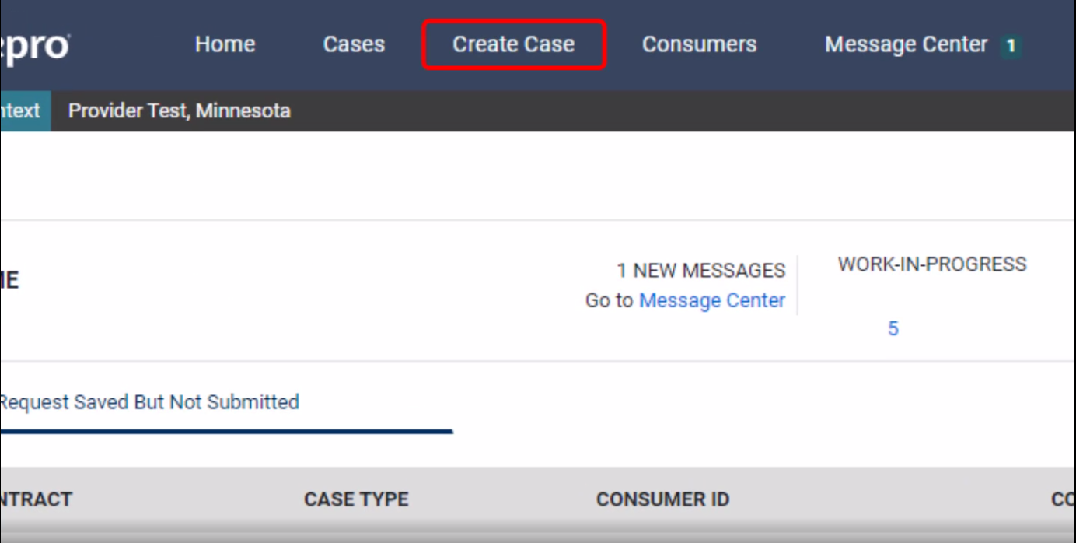
Atrezzo Provider Portal
Successful Completion of setup/login directs user to the Home Page
After logging in from the home screen, click on “Create Case”.

Slide 5
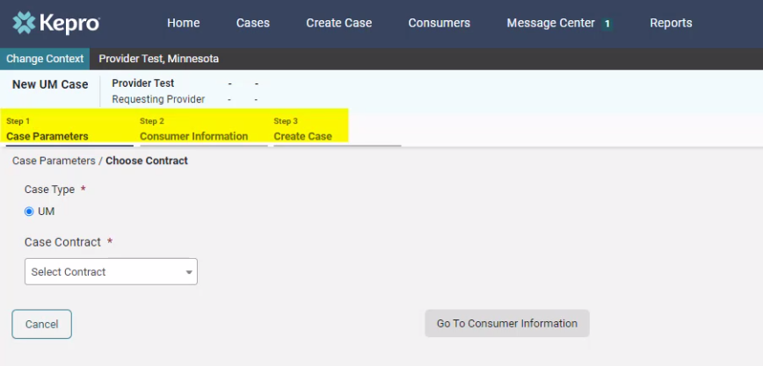
Atrezzo Provider Portal
The Create a Case Wizard shows each section as a Step. The required information will be indicated by a red asterisk (*).
Create Case Wizard

Slide 6
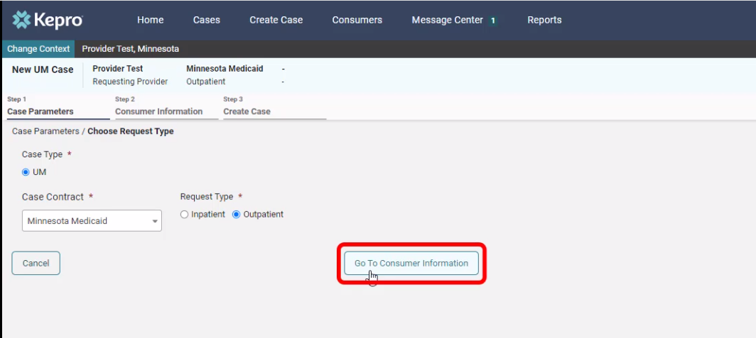
Atrezzo Provider Portal
Case Parameters
Choose:
Case Type: “UM”
Case Contract: “Minnesota Medicaid”
Request Type: “Outpatient”.
Click “Go To Consumer Information” to continue.

Slide 7
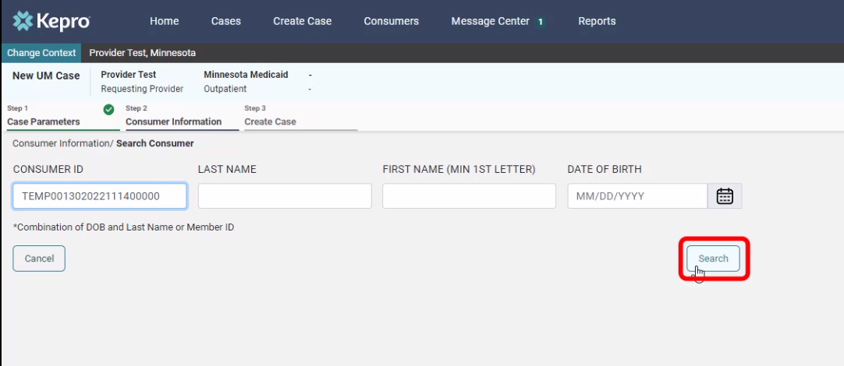
Atrezzo Provider Portal
Consumer information
Search members by:
MN Member ID
Last Name & DOB
Click “Search to continue”

Slide 8
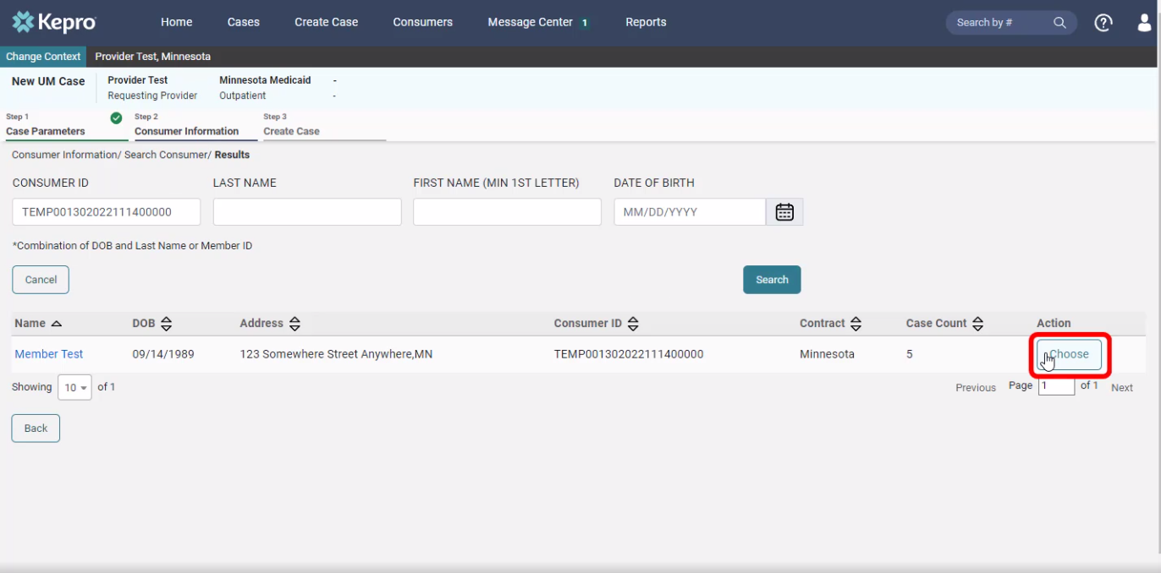
Atrezzo Provider Portal
The members demographic information will display.
Consumer information
Verify member information.
Click “Choose” to continue.

Slide 9
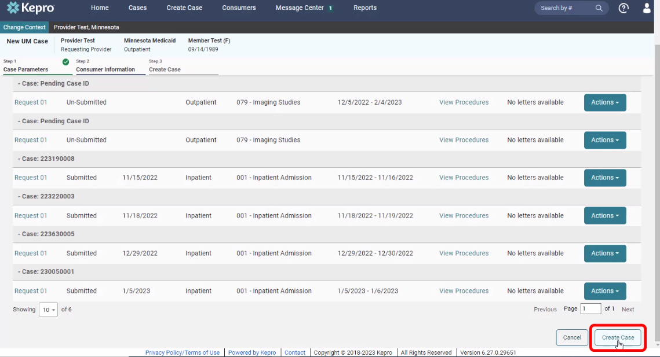
Atrezzo Provider Portal
Consumer information
Previous cases submitted for this member will be displayed.
Click on “Create Case” to continue.

Slide 10
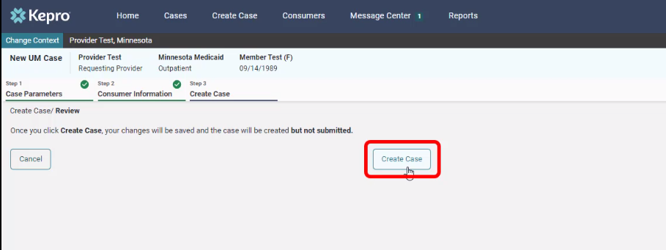
Atrezzo Provider Portal
Disclaimer
CREATE CASE
Notification prompt displays:
“Once you click Create Case, your changes will be saved and the case will be created; BUT
Case WILL NOT be submitted”

Slide 11
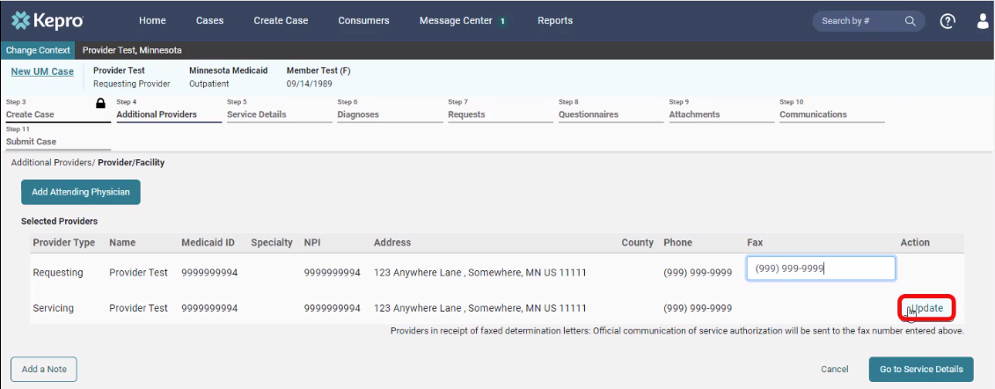
Atrezzo Provider Portal
Additional providers
Entering the attending physician is not necessary for dental
Update the Servicing Provider by clicking on “Update”

Slide 12
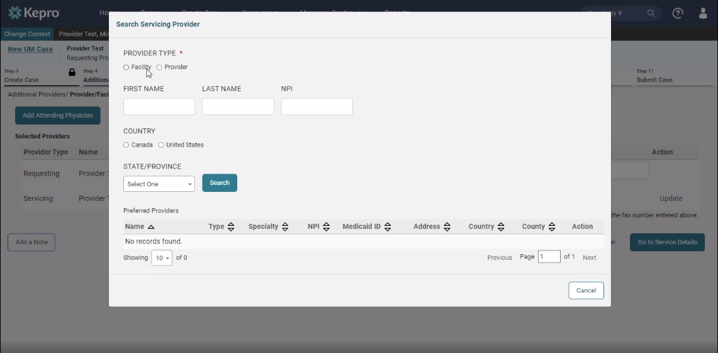
Atrezzo Provider Portal
ADDITIONAL PROVIDERS
If registered as a facility, search using “Facility”.
If registered as a provider, search using “Provider”.
*Reminder: NPI entered under Servicing Provider will be the NPI used to create PA for DHS.

Slide 13
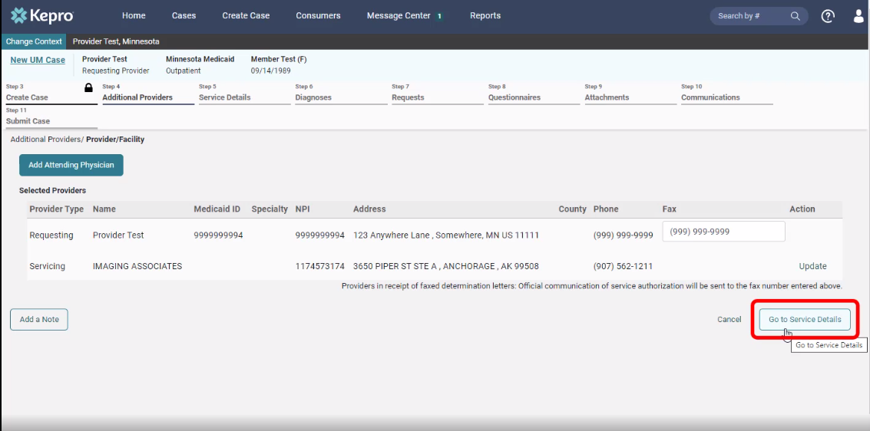
Atrezzo Provider Portal
ADDITIONAL PROVIDERS
Verify provider information
Click on “Go to service details” to continue.

Slide 14
Atrezzo Provider Portal
11
Service details
Choose:
Place of Service: “Office”
Service Type: “Dental- Office”
Click on “Go to Diagnosis” to continue

Slide 15
Atrezzo Provider Portal
12
diagnosis
Choose:
Code Type: “ICD 10” from the drop down,
Enter the diagnosis code to search
Select the correct code from the drop down,
Click “Go to Requests” to continue

Slide 16
Atrezzo Provider Portal
13
requests
Choose Request Type: Prior Auth or Retro
The notification date and time will display.
Click on “Go to Procedures” to continue.
FIPS Code field is not required for dental submissions, leave blank and continue.

Slide 17
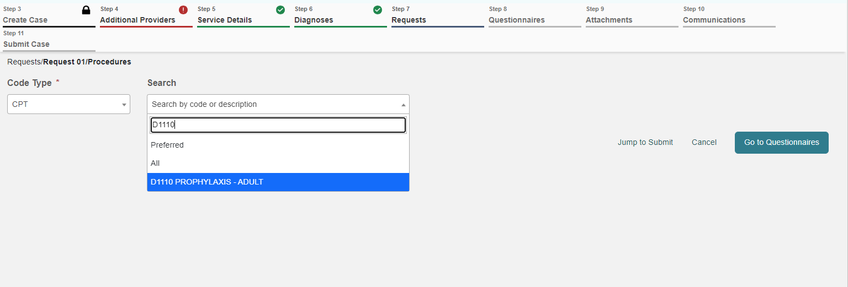
Atrezzo Provider Portal
14
requests
Enter the procedure code in search bar
Choose the correct code from the drop-down.

Slide 18
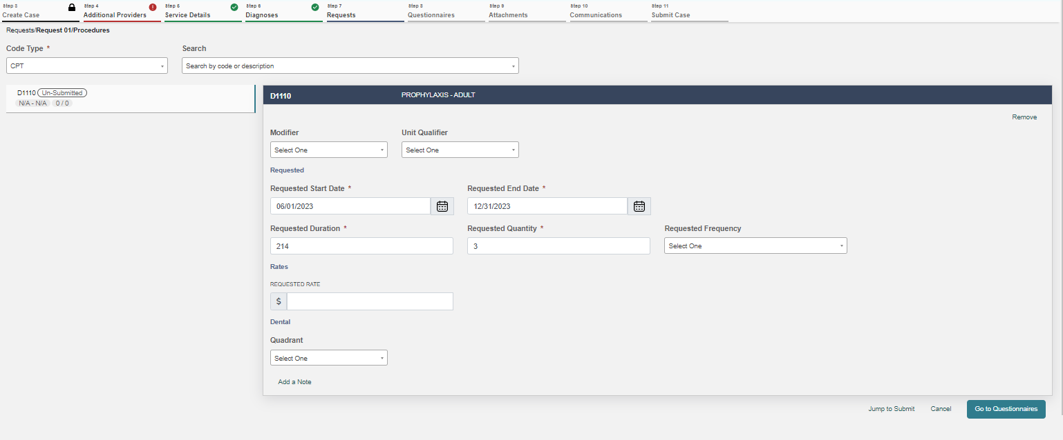
Atrezzo Provider Portal
15
Requests
REQUEST 01 WILL DISPLAY
Enter Requested Start Date.
Enter the Requested Duration (this will populate the correct Requested End date).
Enter the Requested quantity.
Repeat the process for additional procedure codes by entering an additional code in the search field.
Click on “Go to Questionaries” to continue.
| Prior Auth – Start Date – Today’s Date (excluding D1110)
| Retro – Use actual dates of service
|Leave Frequency, Rate, and Modifier(s) blank
*For SRP codes D4341 and D4342, please create a request line for each quadrant and choose the correct quadrant on the lower left.
*Providers are not permitted to submit cases as “insufficient information” status (warning message will pop-up that will prompt you to correct the error).

Slide 19
Atrezzo Provider Portal
16
questionnaire
If there are any questionnaires required for completion, they will be displayed here.
Click on “Take” under Action to complete the questionnaire.
Upon questionnaire completion, click on “Go to Attachments” to upload the documents.

Slide 20
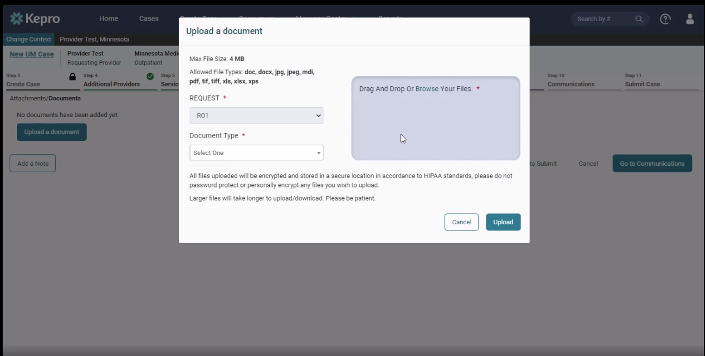
Atrezzo Provider Portal
17
attachments
Click on “Upload documents.”
*You can drag and drop your documents, or you can browse your files.
Once the documents are chosen, click on “Upload.”

Slide 21
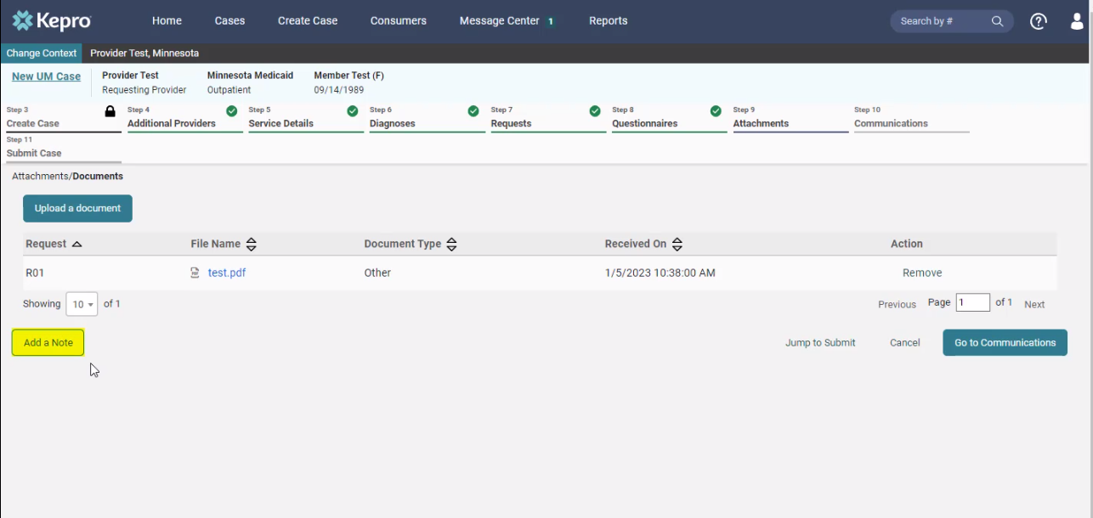
Atrezzo Provider Portal
18
Case note
Each step has a “Add a note” button displayed on the bottom left.
*A note can be added any time throughout the creation of the request; however, it is not necessary.
*Please be advised when responding to this request, clinical rationale/medical necessity information must be captured within the physical record (written documentation) and not solely entered as a case note.

Slide 22
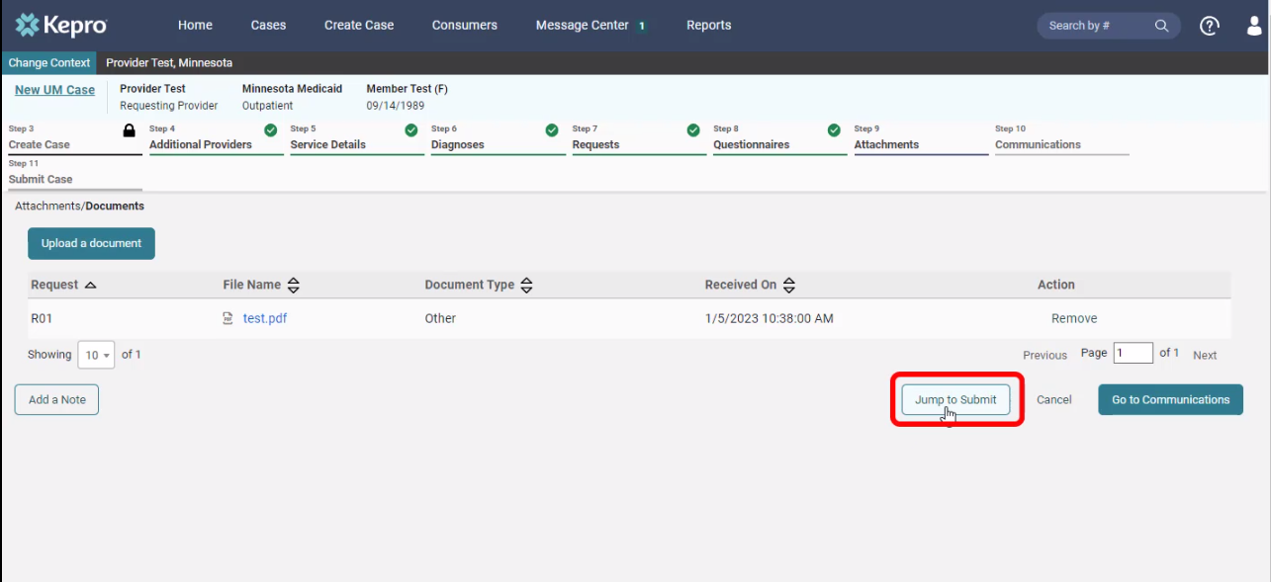
Atrezzo Provider Portal
19
attachments
Click on “Jump to Submit” when all the steps are completed, and a case note has been entered (if necessary).

Slide 23
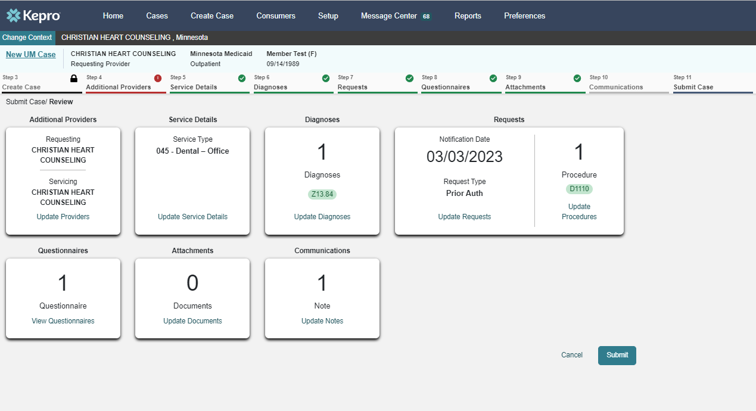
Atrezzo Provider Portal
20
communications
Review the request.
If any changes need to be made, click on “Update” in any section.
If everything is correct, click on “Submit”.

Slide 24
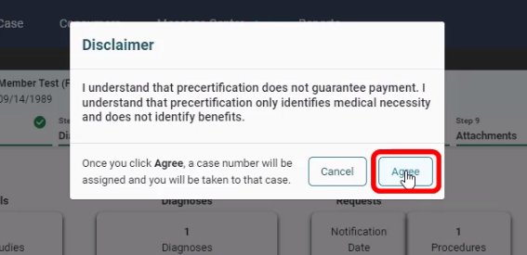
Atrezzo Provider Portal
21
disclaimer
Click “Agree” on the disclaimer.

Slide 25
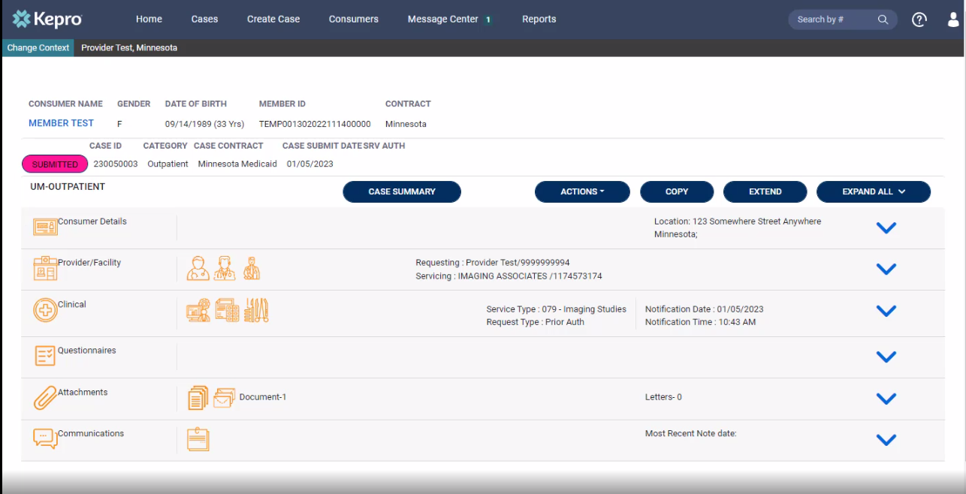
Atrezzo Provider Portal
22
completion
Completed request that is now ready for review by Kepro staff.
Please print or record case number. This will allow for tracking case status, checking for pended information requests or to enter questions into the messaging system.

Slide 26
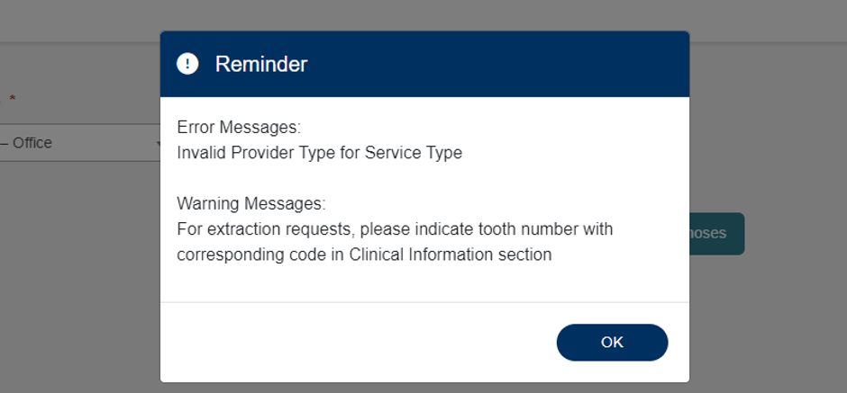
Atrezzo Provider Portal
23
Error messages
If applicable, error messages will appear, prohibiting request submission.
Errors will disappear as information is added or corrected.
If “Invalid Provider Type” error message appears, an incorrect provider type was selected.

Slide 27
Question & Answer

Slide 28
Thank you for attending!
Please reach out with any questions you may have.
Contact Info
1 (866) 433-3658
DentalMNMedicaid@Kepro.com
https://mhcp.kepro.com/

